Slide 1



REI Expansion
Paige Goetsch, Houston Brackett, Jessica Sheehan, Oliver Liston, David Greenberg

Slide 2
Executive Summary
BPS & BEP
Market Entry & Segmentation
Recommendation
-
SWOT
Targeting Strategy

Slide 3


Brand Positioning
REI provides outdoor enthusiasts with a greater selection and quality of goods and services than any other outdoor retailer. We do this by selling quality products, offering equipment rentals, providing expert advice, and through REI adventures.

Slide 4

Brand Equity
Overall Equity
A life outdoors is a life well lived
PoD: Co-Op membership
PoP: High quality, community focus
Strategic Equities
Quality goods, equipment rentals, expert advice, REI adventures, classes and events
Reasons to Believe
Consumer CO-OP based around love for outdoor recreation
Brand Character
Notes:
PoP or PoD for strategic equities
Equities consumers experience?
Better design

Slide 5
SWOT Analysis
Strengths
Weaknesses
Opportunities
Threats
Variety of products
Advocates for sustainability and recycling
One stop shop for all outdoor needs
Location and employment
Employment rates
Lots of recreational opportunities
Tourism is increasing
Expropriation
Competition among brands
Higher interest rates (4-10%)

Slide 6
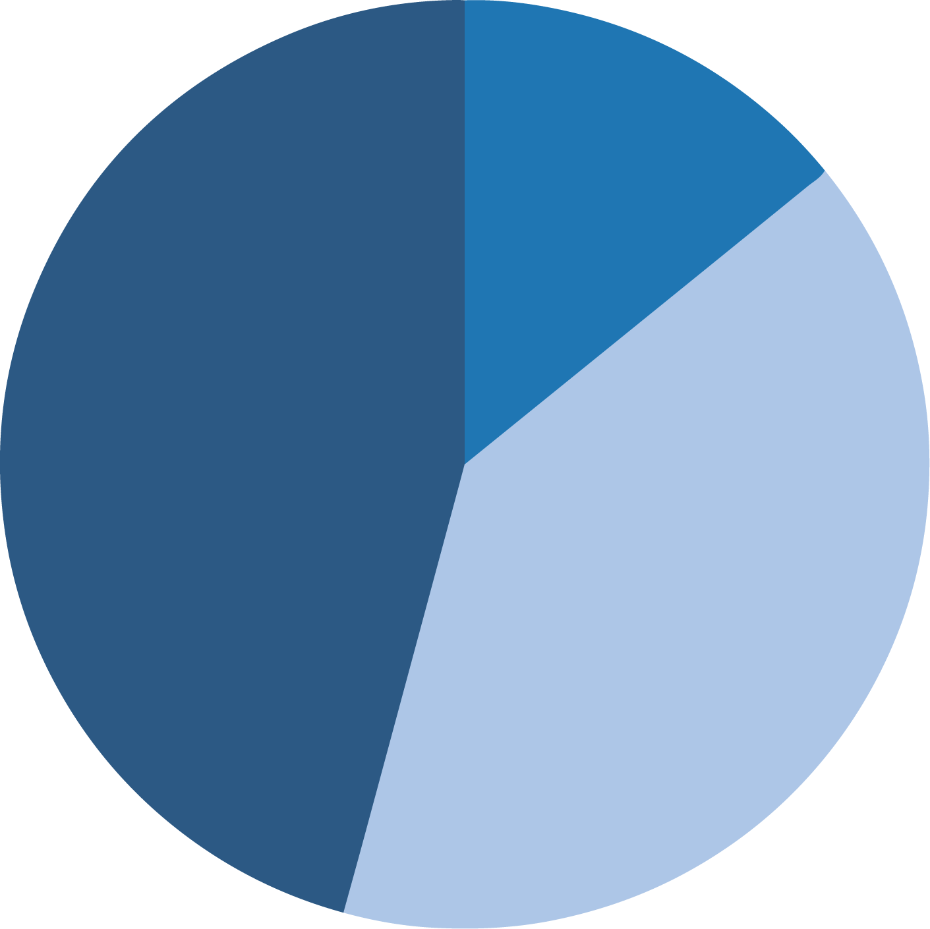
Total Sales By Region
AMER
67,866
Market Entry
EMEA
219,702
Expand to the EMEA region
Set up warehouses
Manage few storefronts
APAC
191,976

Slide 7
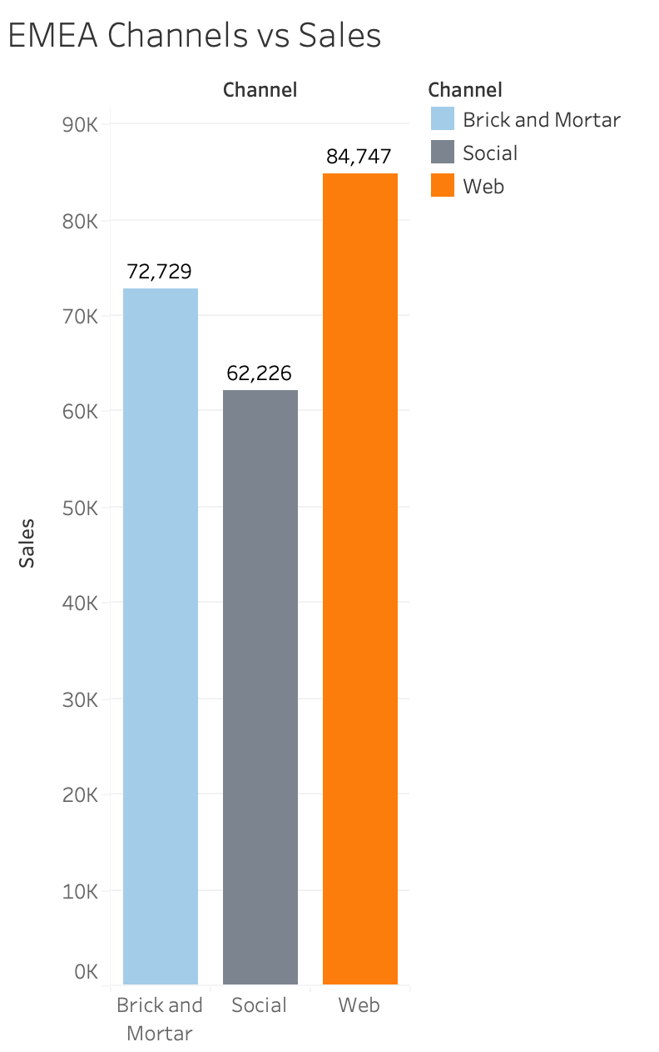
Segmentation
Web sales have highest total sales in EMEA
Upward trend of online sales
Flexible distribution
Notes:
As Houston previously mentioned, we found the EMEA to be the region with the most sales and potential profitability.
The next thing we had to look at was the channel which we would distribute products.
As shown in the graph, web based sales accounted for the highest sum of total sales in the EMEA region.
There has been a general upward trend of online sales, and this will most likely continue as technology increases. this makes the strategy predictive of the future.

Slide 8
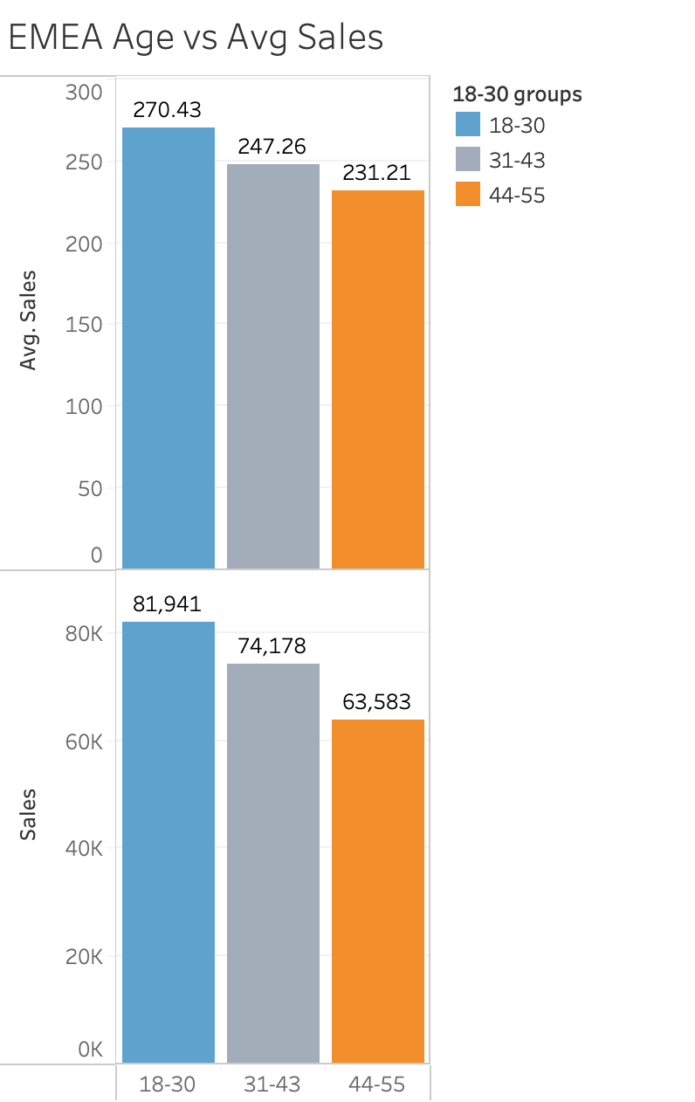
Age Demographic
18-30 Has highest average and sum sales
Prominent demographic for web sales
Notes:
Next, we looked at the target demographic for the product. In both average and sum sales, the 18-30 age demographic was the most lucrative.
We also expected this demographic to be more interested in using web based shopping services.

Slide 9

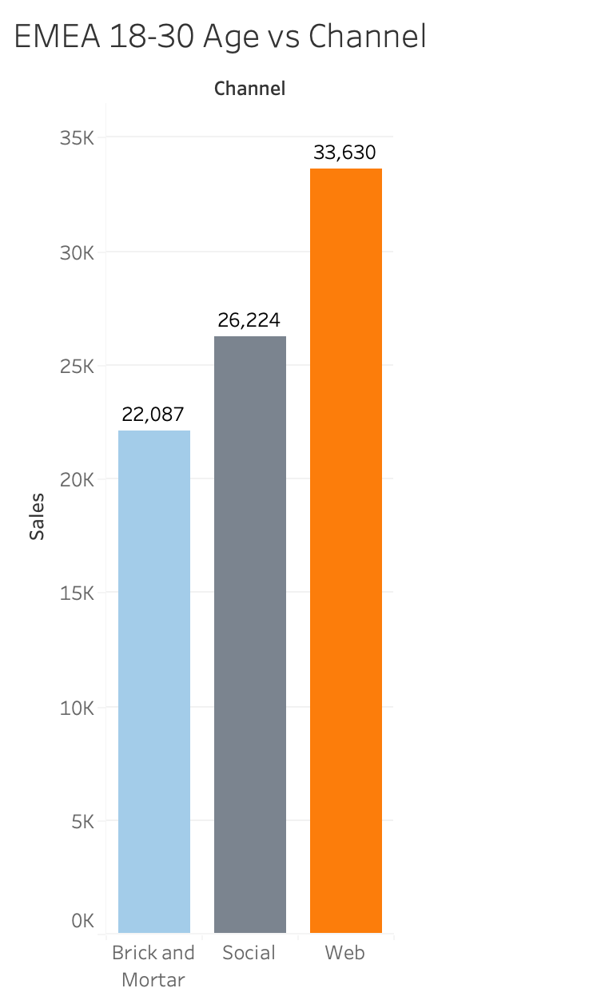
Age 18-30 the spends most on web sales in the EMEA region
Notes:
And so, we found this to be evident in the data, as the highest sum of sales from this demographic does come from online sales.

Slide 10

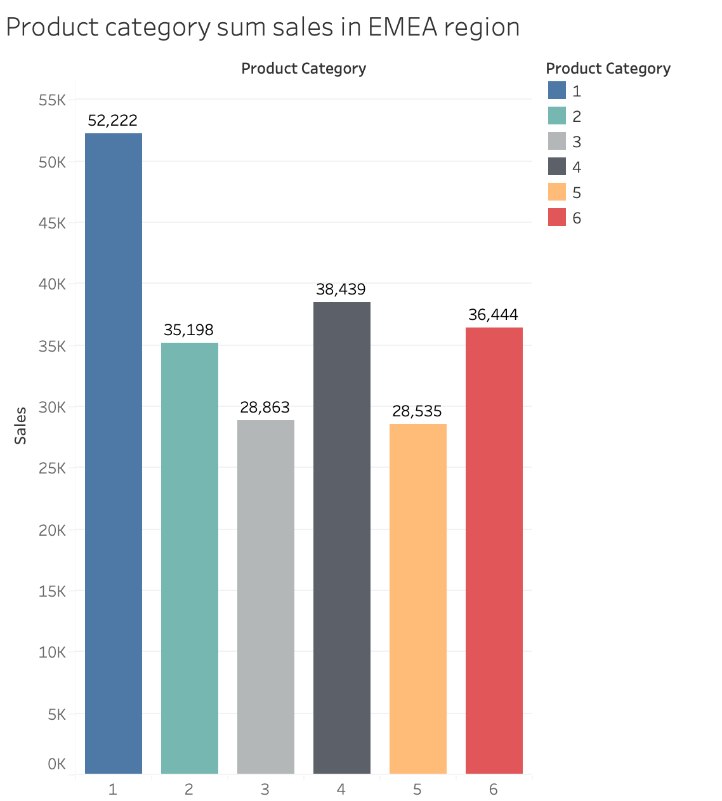
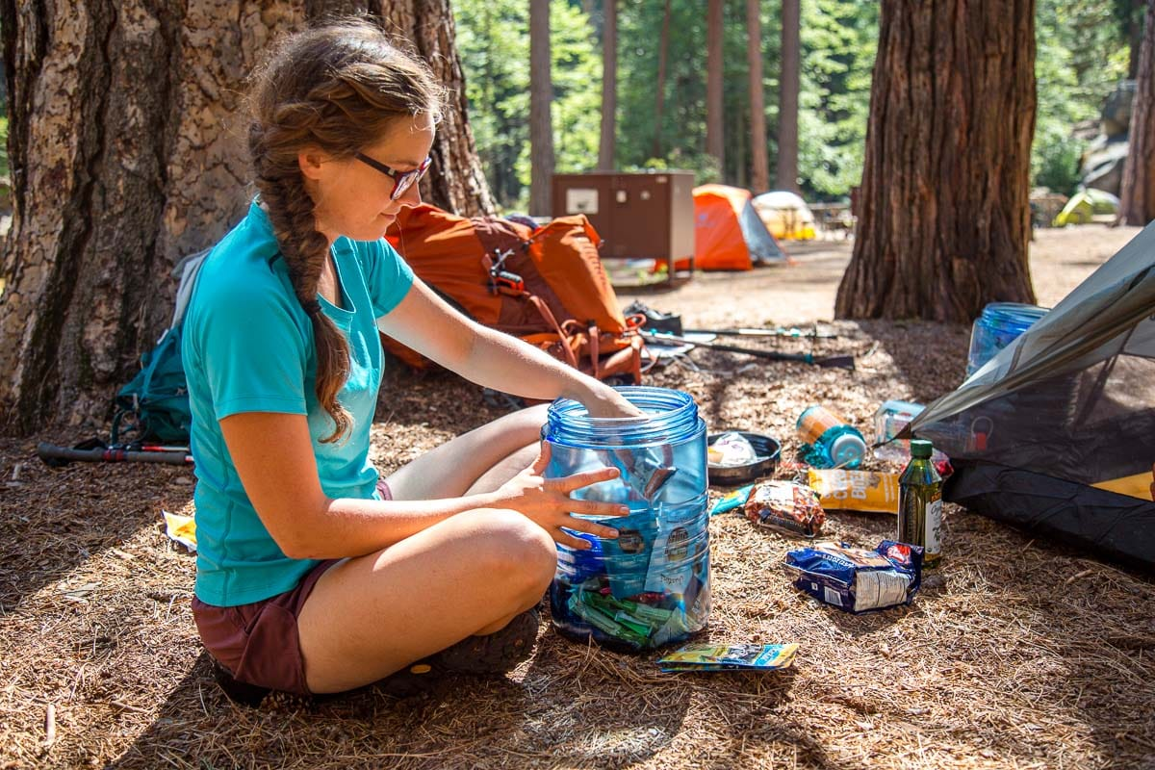
Product 1 has highest total sales in EMEA
Product Category
18-30 Age range is mainly where people buy
camping gear
Notes:
Lastly, we had to find which product category was the most profitable in the EMEA region. Category 1 had the highest sum of sales in the region.

Slide 11

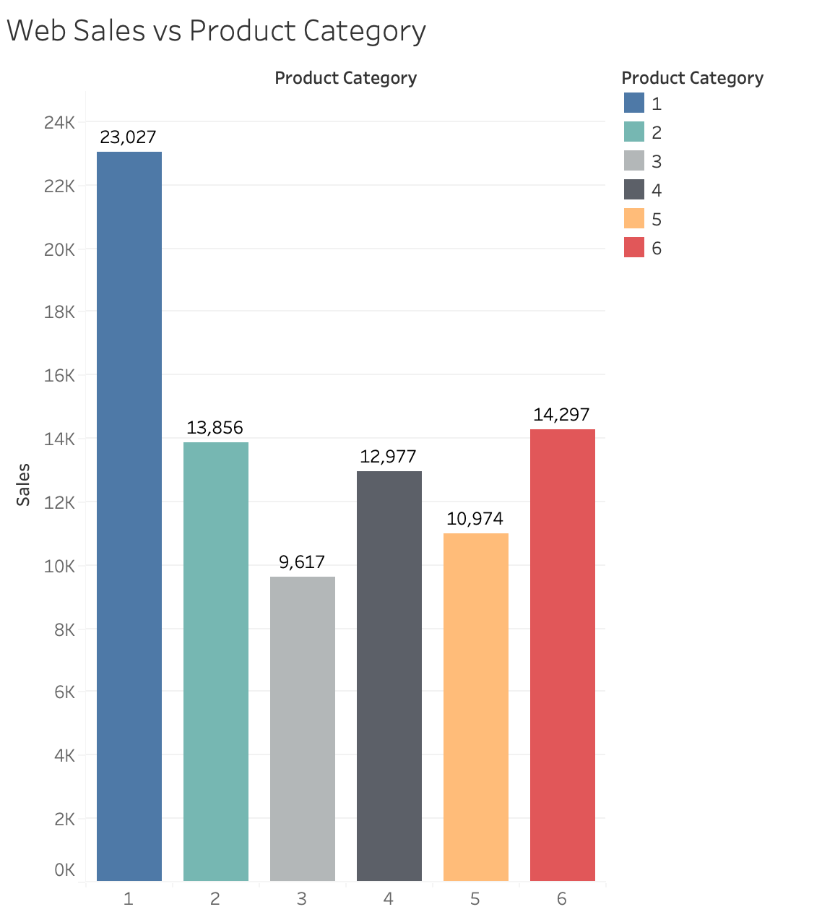
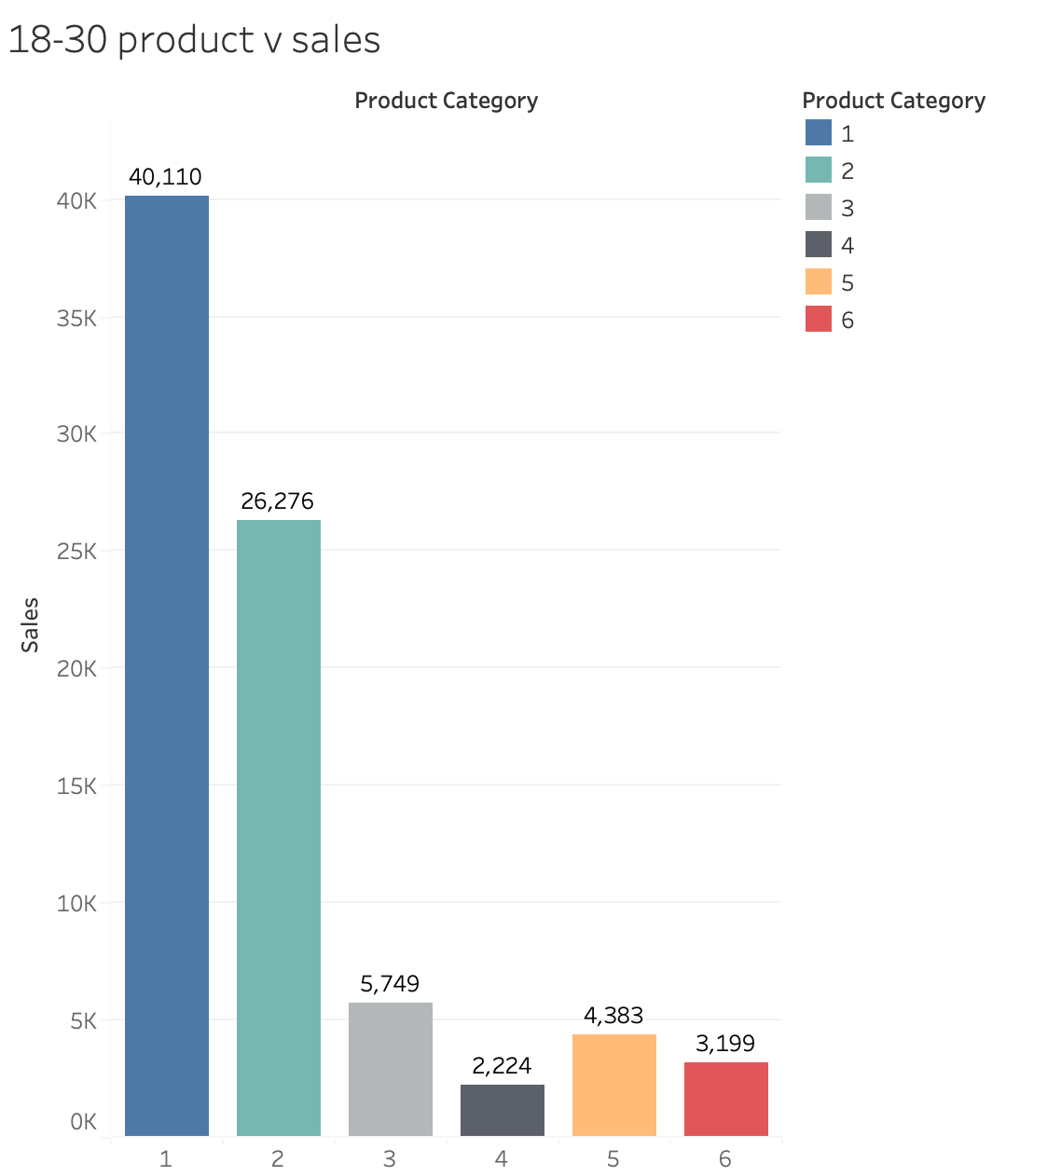

Product 1 has highest online sales
Product 1 has highest sales for age 18-30
Notes:
Not only that, product 1 is also the highest selling product category for online sales alone, a clear indicator that this product is selling online. Additionally, for the 18-30 age demographic, product 1 is significantly higher in sales than the other product types, meaning that it would synergize with both online sales and the age demographic. We believe that targeting the EMEA region with a specific focus on product 1, web sales, and the age demographic of 18-30. These will give REI the biggest advantage in licensing the brand outside of the US.

Slide 12
Thank you!

Slide 13
Sources
https://ibis.accor.com/gb/editorial/article/top-10-adventure-bucket-list-for-outdoor-addicts-in-the-middle-east-3-80000.shtml
https://www.condorferries.co.uk/tourism-in-europe-statistics#:~:text=EU%20TOURISM%20ARRIVAL%20STATISTICS&text=Global%20visitors%20to%20EU%20destinations,a%205.5%25%20increase%20from%202017.
https://papersowl.com/examples/recreational-equipment-incorporated-swot-analysis/#:~:text=Some%20significant%20strengths%20of%20REI,co%2Dop%20in%20the%20nation.

